Slide 1
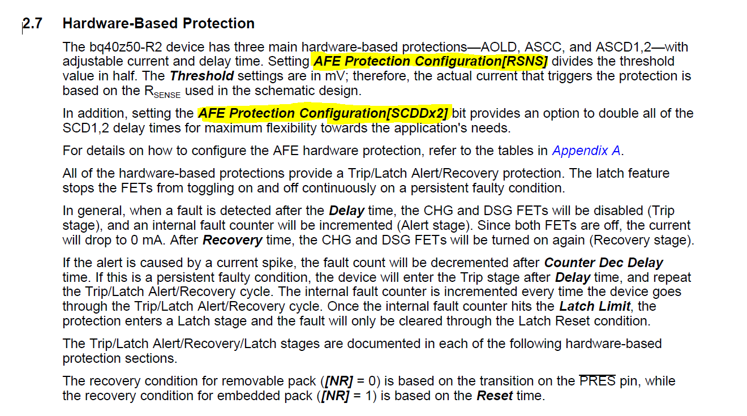

Slide 2
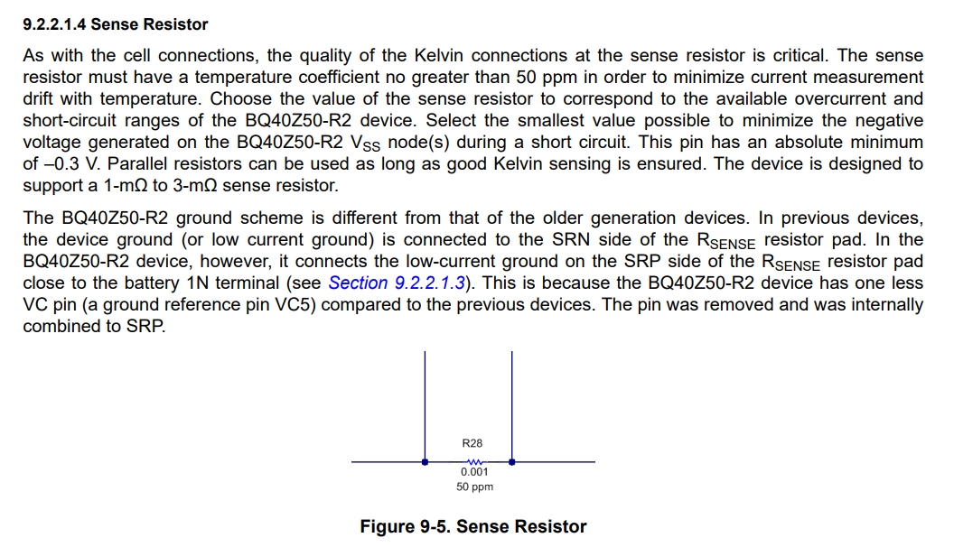
We have two parallel 3w m2Ω as a sense resistor

Slide 3
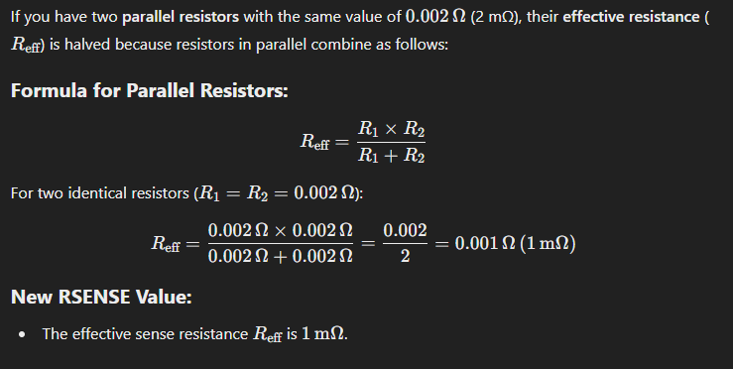

Slide 4
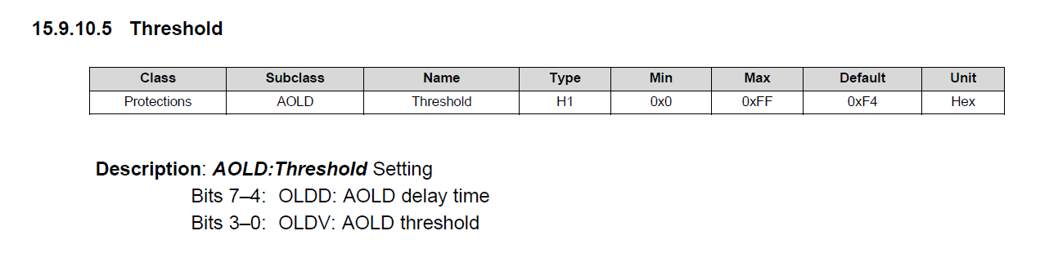


Default 0xF4 (hex)
1111 0100
0x0f 0x04
31ms -19.42mV
Update 0xF6 (hex)
1111 0110
0x0f 0x06
31ms -24.98mV

Slide 5
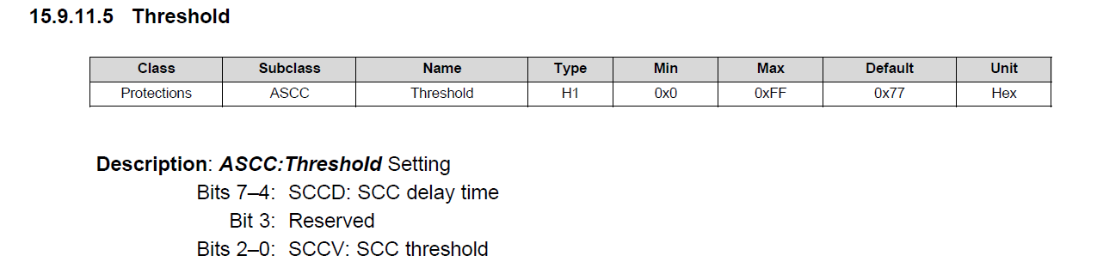



Default 0x77 (hex)
0111 0111
0x07 0x07
427µs 100mV
Default 0x72 (hex)
0111 0010
0x07 0x02
427µs 44.4mV

Slide 6
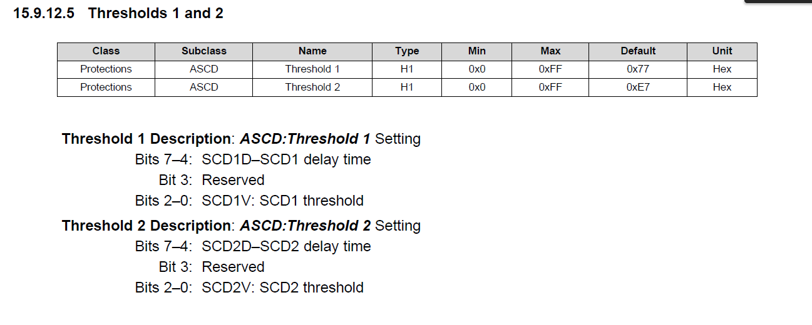




Default ASCD1 0x77 (hex)
0111 0111
0x07 0x07
427µs -100mV
Update ASCD1 0x72 (hex)
0111 0010
0x07 0x02
427µs -44.4mV
Default ASCD2 0xE7 (hex)
1110 0111
0x0E 0x07
854µs -100mV
Update ASCD2 0xE4 (hex)
1110 0100
0x0E 0x04
854µs -66.65mV

Slide 7
Updated:
AOLD: Latch Limit: 5
ASCD: Latch Limit: 3
ASCC: Latch Limit: 3
Other Parameters:
AOLD, ASCD, ASCC
Using Default:
Counter Dec Delay: 10secs
Recovery: 5secs
Reset: 15secs
Default:
AOLD: Latch Limit: 0
ASCD: Latch Limit: 0
ASCC: Latch Limit: 0

